Slide 1

CUSTOMER RETENTION ANALYSIS
By
Jyoti Chandola

Slide 2
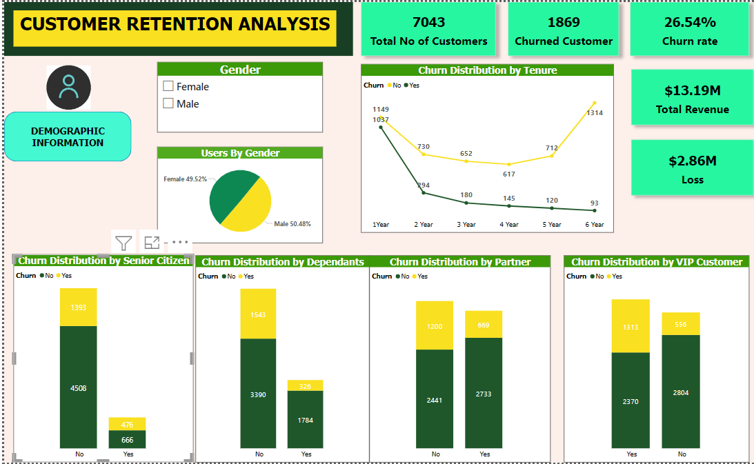
DEMOGRAPHIC INSIGHTS
The Gender distribution is Even.
Customer of tenure 1 Year has maximum churn rate
According to graph we prefer customers with monthly charges >= $ 69.5 as VIP Customers, and the churn rate of VIP Customers is high as maybe they are paying high still not getting satisfied service
Dependency and marital Status does not affect the churn rate much.

Slide 3
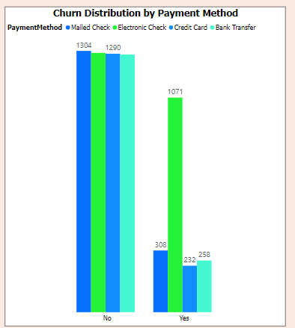
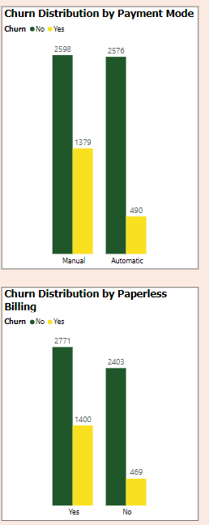
Payment Method and Payment Mode
Maximum Churn Customers are those who are using Electronic Check as payment method which comes under manual Mode of payment.
Manual mode of payment has a higher rate of churn than automatic mode of payment.

Slide 4
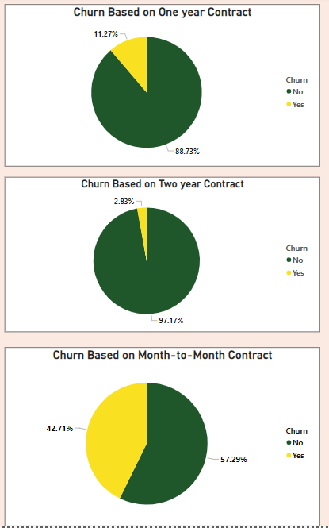
Churn Rate based on Contract
Maximum Churn rate of 42.71% of customers having Month-to Month Contract.
Longer the contract the lesser the churn.

Slide 5
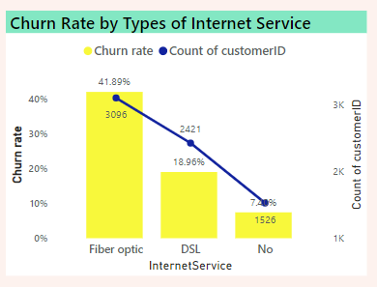
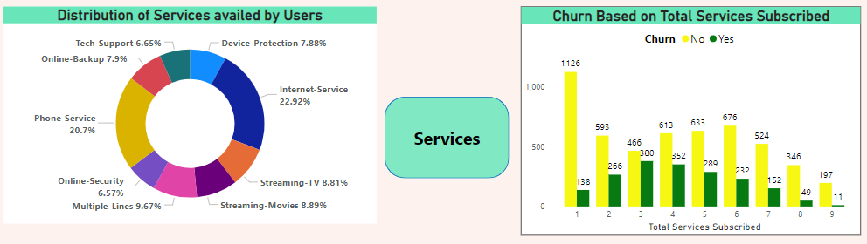
Churn Rate based on Subscription
22.92% of customers availing Internet service, other services should also be looked upon to make customer avail other services also.
Maximum Customers are using Fiber optic and higher churn rate of Fiber optic , it must be checked for this service to make it much better
Trend of the Churn rate based on services subscribed is not straight , so we cannot say that higher the no. of subscription the higher the churn.

Slide 6
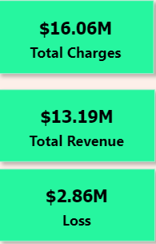
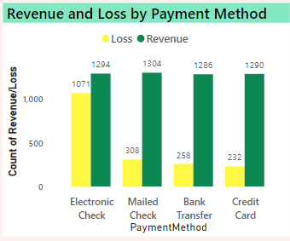
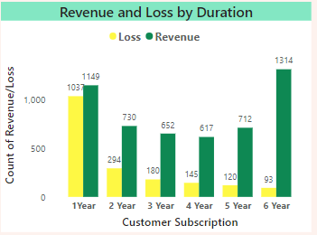
Revenue and Loss
Maximum Loss is observed in Electronic check payment method therefore it should be checked what is the issue in this payment method as customers prefer this payment method the most and maybe they are not getting expected service.
Customers who has been with us since 5+ years are top customers, and the churn rate is also less of these customers due to which loss is also less occurred therefore more efforts should be made to retain such customers.

Slide 7
Project Ends Here

